Slide 1

SIMULATION OF NON-NEWTONIAN FLOW USING ANSYS
SUBMITTED IN THE PARTIAL FULFILLMENT
OF THE REQUIREMENT FOR THE DEGREE OF BACHELOR OF TECHNOLOGY
IN
CHEMICAL ENGINEERING
UNDER THE GUIDIANCE
OF
Dr. MALIK PARVEEZ
By
SHIVAM SPOLIA (2017BCHE018)
AMOLDIP SINGH NARANG (2017BCHE053)
MANISH SAINI (2017BCHE055)

Slide 2
INDEX 1.INTRODUCTION 2. LITERATURE REVIEW 2.1 CLASSIFICATION OF FLUID BEHAVIOUR 2.1.1 DEFINATION OF NEWTONIAN FLUID 2.1.2 NON NEWTONIAN FLUID BEHAVIOUR 2.2 TIME INDEPENDENT FLUID BEHAVIOUR 2.3 TIME DEPENDENT BEHAVIOUR FIGURE 1 FIGURE 2 FIGURE 3 3. GENERAL EQUATION OF BEND 3.1 DEAN NUMBER 3.2 FRICTION FACTOR 4. CFD ANALYSIS 4.1 MATHEMATICAL MODEL 4.2MEASUREMENT OF RHEOLOGICAL PROPERTIES 4.3 GOVERNING EQUATIONS 4.4 BOUNDARY CONDITIONS 4.5 ASSUMPTION OF SCMC SOLUTION FLOW 4.6 CFD PROCEDURE 5. RESULTS AND DISCUSSION 5.1 NUMERICAL SIMULATION 5.2 90’ BEND PIPE FIGURE 4 FIGURE 5 FIGURE 6 FIGURE 7 FIGURE 8 FIGURE 9 5.3 U BEND PIPE FIGURE 10 FIGURE 11 FIGURE 12 FIGURE 13 FIGURE 14 FIGURE 15 FIGURE 16 FIGURE 17 5.4 DISCUSSION | SLIDE NUMBER 3 5 5 5 7 8 9 5 7 9 10 10 11 12 12 13 14 15 15 16 16 16 17 21 22 23 24 24 24 25 28 29 30 31 32 33 34 35 36

Slide 3
1. INTRODUCTION
Non-Newtonian pseudo plastic fluids flow through bends are more complicated compared to the simple straight pipe as the bends are associated with different curve geometry.
Bends are mainly used in petroleum and Refinery, Pharmaceutical, Rubber, Paper Pulp and Food industries as piping components for fluid transfer and as heat transfer equipment in boiler, heat exchanger, distillation column, and aircrafts.
Since the bends are curved in nature, the fluids entering in the bend influence the combined centrifugal and viscous forces.
We have considered Dean Number (De) to explain the flow phenomena inside the bends. The De plays a same role as Reynolds Number (Re) in a straight pipe.
The velocity and pressure distribution inside the bends generate centrifugal and secondary flow which will transfer the denser fluid to the outer wall of the bend at a faster rate compared to the lighter fluid.
The fluid will return to the inner wall side of the bend after collision with the outer wall. This creates a transverse pressure gradient in the form of kinetic energy and also pressure loss across the bend.

Slide 4
CONTINUED,
The prediction of pressure drop through bend is uncertain as the combined skin friction loss and loss due to changes in flow direction may explain the mechanism of flow phenomena inside the bends.
CFD analysis of non-Newtonian pseudo plastic flow through bends is important as it may be used as a complement to an experiment and also to lower the time and experimental cost of equipment.
It gives us the conceptual studies of new design, redesign, detailed product development, troubleshooting with the help of numerical techniques where mass, momentum, energy, species are involved.
So, the experimental and CFD analysis, both are required to predict the flow phenomena inside the bends

Slide 5
2. Literature Review
2.1 Classification of Fluid Behaviour
2.1.1 Definition of a Newtonian Fluid
In simple shear (Fig. 1), the response of a Newtonian fluid is characterized by a linear relationship between the applied shear stress and the rate of shear, i.e.,
σyx = F/A = ηγyx (1)
Fig. 1 and equation (1), represent the simplest case wherein there is only one non-zero component of velocity, Vx, which is a function of y.

Slide 6
For the general case of three-dimensional flow (Fig. 2), clearly there are six shearing and three normal components of the stress tensor, S.
Split the total stress into an isotropic part (pressure) and a deviatoric part as
S = −pI+σ (2)
Where σ is traceless, i.e., tr · s = 0, and pressure is consistent with the continuity equation.
The trace free requirement together with the physical requirement of symmetry s = s T imply that there are only three independent shear components and two normal stress differences of the deviatoric stress.
In Cartesian coordinates, these are sxy(= syx),sxz(= szx),syz(= szy) and the two normal stress differences defined as
Primary normal stress difference, N1 = sxx −syy (3)
Secondary normal stress difference, N2 = szz −syy (4)
For Newtonian fluids, these components are related linearly to the rate of deformation tensor components via the scalar viscosity. For instance, the three-stress com ponents acting on the x face (oriented normal to the x axis) in Fig. 3 are written as follows

Slide 7
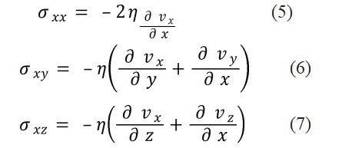
For instance, the three-stress com ponents acting on the x face (oriented normal to the x axis) in Fig. 3 are written as follows
For a Newtonian fluid, in simple shear, sxx = syy = szz = 0, because Vx only varies in thSimilar sets of equations can be set up for the stress components relevant to the e y direction. Thus, the complete definition of a Newtonian fluid requires it to satisfy the complete Navier-Stokes’s equations rather than simply exhibiting a constant value of shear viscosity.
FIG. 2 STRESS COMPONENTS IN THREE-DIMENSIONAL FLOW

Slide 8
2.1.2 Non-Newtonian Fluid Behavior
In non-Newtonian fluids, viscosity can change when under force to either more liquid or more solid.
The apparent viscosity, defined as s/g˙, is not constant and is a function of s or g˙.
Under appropriate circumstances, the apparent viscosity of certain materials is not only a function of flow condition, but it also depends on the kinematic history of the fluid element under consideration.
It is convenient, though arbitrary to group such materials into the following three categories:
1.Time-independent or generalized Newtonian fluids
2. Time-dependent fluids
3. Systems which exhibit a blend of viscous fluid behavior and of elastic solid-like behavior i.e visco-elastic fluids

Slide 9
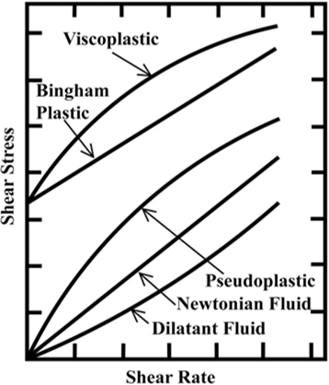
2.2 Time-Independent Fluid Behaviour
In simple unidirectional shear, this sub-set of fluids is characterized by the fact that the current value of the rate of shear at a point in the fluid is deter- mined only by the corresponding current value of the shear stress and vice versa.
such fluids have no memory of their past history.
Thus, their steady shear behavior may be described by a relation of the form,
Depending upon the form of equation (8) three possibilities exist:
1. Shear- thinning or pseudoplastic behavior
2. Visco-plastic behavior with or without shear-thinning behavior
3. Shear- thickening or dilatant behavior.
Fig.3 Qualitative flow curves for different type of non- Newtonian fluid
figure 3 Qualitative flow curves for different types of non- Newtonian fluid

Slide 10
2.3 TIME DEPENDENT BEHAVIOUR
The viscosity of the fluid is dependent on temperature, shear rate and time.
Can’t be described by a simple mathematical expression of the form of eq. (8).
Depending on how viscosity changes with time the flow behaviour is characterised as:
Thixotropic (time thinning, i.e. viscosity decreases with time)
Rheopectic (time thickening, i.e. viscosity increases with time)
Thixotropic fluids are quite common in chemical as well as in food industry. Rheopectic fluids are very rare.
Examples:
Thixotropic: yoghurt, paint
Theopectic: gypsum paste

Slide 11
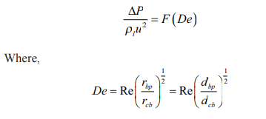
3. General equation of Bend
3.1 Dean number
A dimensionless number expressed as the ratio of the square root of the product of inertia and centrifugal forces to the viscous forces.
De is introduced into the curved pipe to show the interaction between centrifugal and viscous forces. So, for curved pipe, De can be expressed as,
..... (9)
In this case, De plays a similar role as Re in a straight pipe

Slide 12


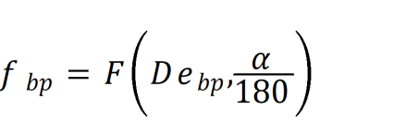
3.2 Friction Factor
The friction factor, fbp for flow through a bend pipe is defined by the Fanning friction factor as
(10)
The following modified equation is used for bend pipe:
The following functional relationship is used to extend the applicability of the Eq. 10 with an angle factor to all the different bends in the horizontal plane
(11)
When bend angle α → 0, radius of curvature of the bend, rcb will be closed to zero, i.e., bend becomes straight and the friction factor, f bp of Eq. 11 will be equal to the friction factor of the straight pipe, f s. By incorporating the above limiting condition,

Slide 13
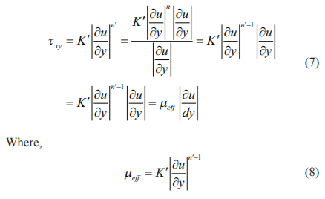
4. CFD Analysis
4.1 Mathematical Model
Dilute solutions of SCMC behave as a time independent non-Newtonian pseudo plastic fluid.
The fluid follows the laminar non-Newtonian pseudo plastic power law model. The k-ε model is used for water in bends in a turbulent region.
The apparent or effective viscosity, µeff are defined from Power law model for non-Newtonian fluids as,

Slide 14
continued
Where,
K′ = consistency index
n′ = flow behaviour index.
The flow behaviour index, n′ is an important parameter to subdivide the fluids as Newtonian (n′ = 1), pseudo plastic (n′< 1) and dilatants (n′ > 1).
The deviation of n′ from unity indicates the degree of deviation from Newtonian behaviour and (n′ < 1) indicates the shear thinning behaviour of pseudo plastic fluids

Slide 15
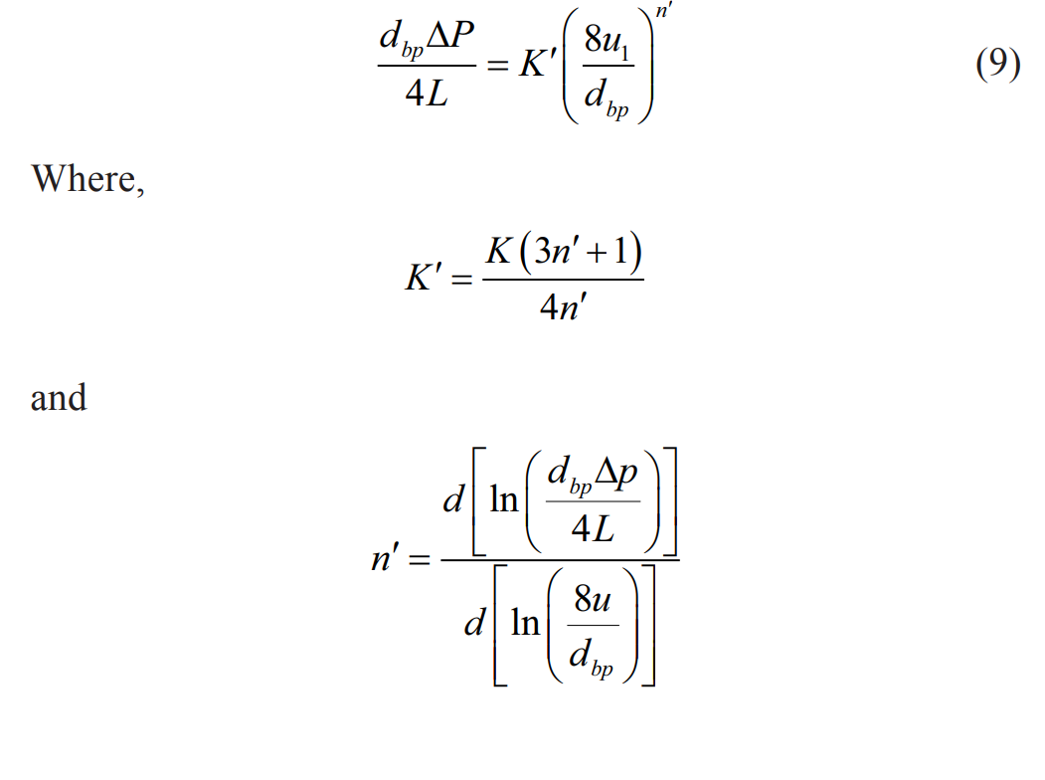
4.2 Measurement of rheological properties
Rheological properties and density of the solutions is measured experimentally by pipeline Viscometer and by the specific gravity bottle.
It is obtained from the intercept and slope of the log-log plot of wall shear stress (dbp ∆P / 4L) vs. shear rate (8ul / dbp).
The basic relationship for power law fluid to relate pressure drop with the flow rate of SCMC solution by means of geometric parameters and the two physical properties of the fluid K′ and n′ is

Slide 16
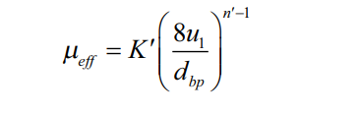

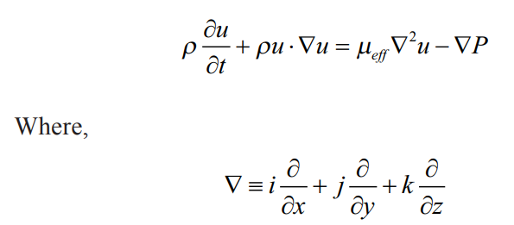
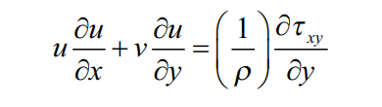
4.3 Governing equation
The effective viscosity is used for the calculation and defined as,
The governing continuity and momentum equations are the Navier-Stokes equation and can be written as,
Continuity equation:
,Where, u is the non-Newtonian, SCMC solution velocity.
Momentum equation:
for steady non-Newtonian, SCMC solution flow, momentum equation is written as,
Where, u and v are the x and y velocity components respectively, τxy is the shear stress nd & ρ is the density of non-Newtonian pseudo plastic fluid (SCMC solution).

Slide 17
4.4 Boundary conditions
The continuity and momentum equations are solved subject to the following boundary conditions:
(a) Assuming bend walls are rigid and hence no slip conditions are introduced.
(b) Velocity is considered as inlet parameter and
(c) The outlet is the pressure of the fluid at the end of the pipe.
4.5 Assumptions of SCMC solution flow through bends
(a) The non-Newtonian pseudo plastic liquid flow through bends is 3-D fully developed and steady. We have used here fully developed i.e., the transition length of 50-80 ID for turbulent and laminar flow.
(b) The fluid is isothermal, incompressible and non-Newtonian.
(c) The temperature of SCMC solution is fixed to 31°C.
(d) Single phase laminar pseudo plastic power law model is considered.
(e) Non-Newtonian pseudo plastic and Newtonian water flow through bend is complex in nature.
(f) Secondary flow appears inside the bend.
(g) It is governed by the conservation of mass and momentum equation with laminar and turbulent flow condition.

Slide 18
4.6 CFD procedure :
Mesh Geometries for the bends are created by using CFD pre-processor.
The inlet is used to specify the inlet velocity and outlet is used to specify the pressure outlet.
The mesh geometries of the bends are imported into CFD solver in 3-D, X, Y, Z Cartesian co-ordinate system.
The pressure based CFD solver solved the governing equations in 3-D geometry.
Laminar non-Newtonian Power Law model has been used for simulation.
The model solves the Navier-stokes equation at prescribes velocities. The governing equations are nonlinear and several iterations of the loop must be performed before a convergent solution is obtained.
The first-order upwind scheme is used in the discretization of a set of governing equations and interpolation schemes are used for calculating cell-face pressures using the segregated solver.
Pressure-velocity coupling refers to the numerical algorithm which uses a combination of continuity and momentum equations to derive an equation for pressure (or pressure correction) while using the segregated solver.
A Simple algorithm is used in CFD solver domains.
The convergence criteria were set at 10-5 for momentum and 10-3 for continuity equation.
The CFD based CGS solver is used for velocity and AMG solver is used for pressure corrector.

Slide 19
5. Results and discussions
5.1 Numerical simulation
The CFD based software is used to numerically simulate the non-Newtonian pseudo plastic liquid flow through bends.
Different geometries of bends are created depending on angle and mesh by using the CFD module.
Unstructured grids with tetrahedral elements are used for generating meshes.
A grid independence study was carried out by varying the number of elements in the bend domain.
Grid having 17055-44000 elements with varying bend angles is found to be sufficient as any further refinement does not produce any change in velocity and pressure profiles at various cross sections.
Velocities corresponding to Reynolds number ranging from 200 to 3000 are used in the simulation for non-Newtonian pseudo plastic liquid flow through bends.
The first order upwind scheme is used for calculation.
A 3-D flow simulation over the entire length of the angular bends has been studied.

Slide 20
The effect of various parameters: bend angle, flow rate or velocity on viscosity, static pressure, pressure drop has been discussed below
5.2 For 90 Degree Bend Pipe :
Radius pipe =10mm
Bend radius=15mm
H= 300mm
V=200mm
Element size=0.0005 m
Behavior=
Viscous model =k omega model
Option = SST production limiter
SCMC= C8H16NaO8
Molecular weight =263.20
Density=0.5=0.7 g/cm^3
= (0.3=0.7 10^=3/10^=6) kg/m^3
= 500=700 kg/m^3

Slide 21
Temperature = 25 c
Viscosity = 1500=3000 centipoise
= 1.5=3 kg/ms
Velocity=6m/s
Turbulence
Specification method: intensity and viscosity ratio
Turbulent intensity= 5%
Turbulent viscosity ratio = 10
Viscosity specification method: magnitude, normal boundary
Change in mass flow rate
Solution methods
1.Scheme = simple
2.spatial discretization

Slide 22
A.gradient=green gauss cell based
B. Pressure = second order
C. Momentum= second order upwind
D. Turbulent kinetic energy= second order upwind
E. Specific dissipation ratio= second order upwind
Monitors:
Residual
Continuity
X= velocity
Y=velocity
Z= velocity
K=eption
Iterations = 50
Plots :
Y=static pressure (pa)
X= position (m)
Cumulative plots:
Y = cummulative force , X= distance (m)

Slide 23
History of static pressure:
Surface integrals
Static pressure(outlet) = - 1.39 3je+ 33
Inlet =
Velocity at inlet =6m/s
Velocity at outlet = 0.0001921141 m/s
Roughness constant = 0.5
Wall motion=stationery
Shear condition=no slip
Roughness model= standard
Area inlet= 0.0156598 m^2
Absolute mass flow average of pressure on inlet = 1.88065e +10 (pa)

Slide 24
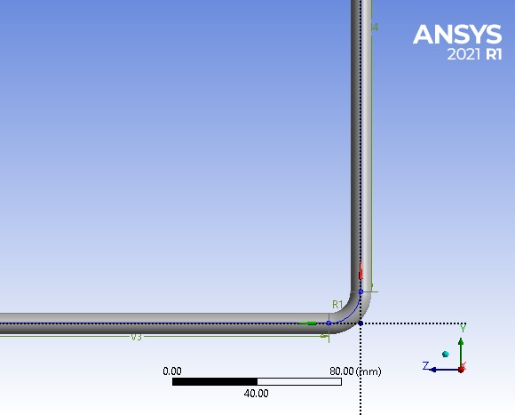
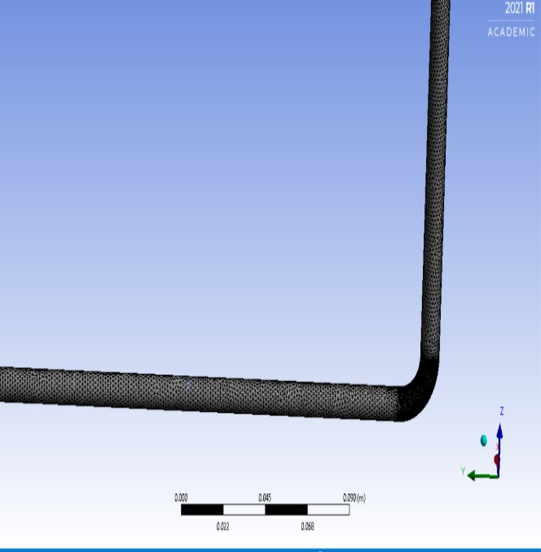
Scaled residuals
(a) geometry
(b) mesh design for 90` bend
fig.4 (a),(b)

Slide 25
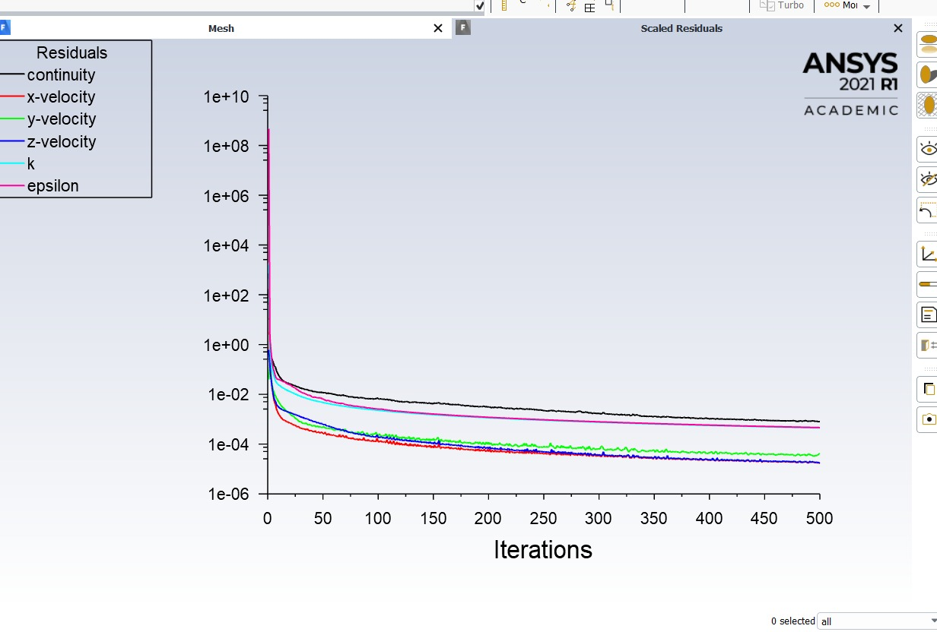
figure 5: scaled residuals vs iteration for 90 degree bend

Slide 26
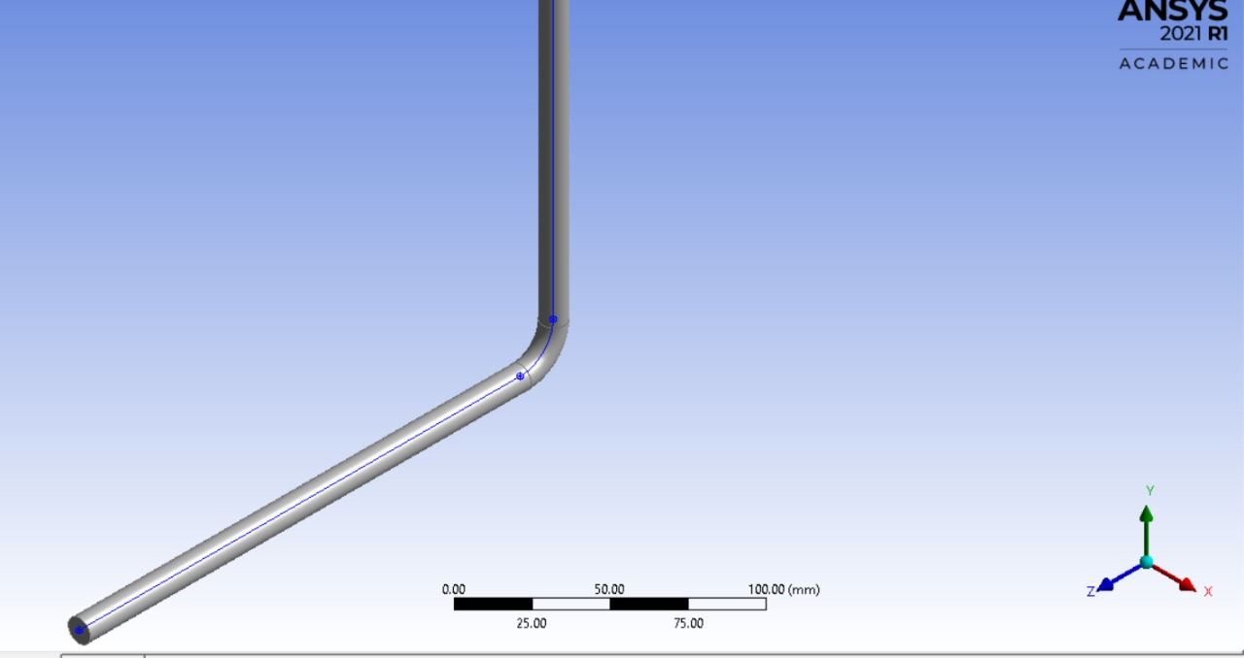
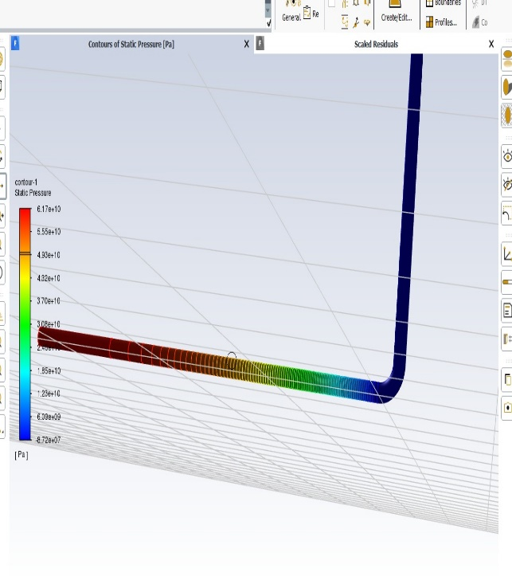
(a)
(b)Static Pressure Contour for 90 Degree Bend
fig. 6 (a),(b)

Slide 27
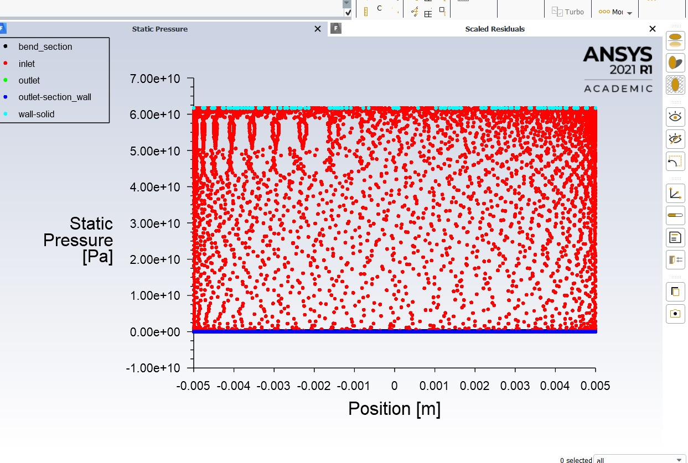
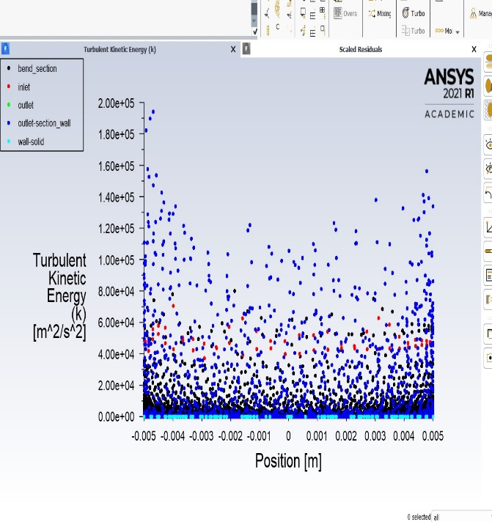
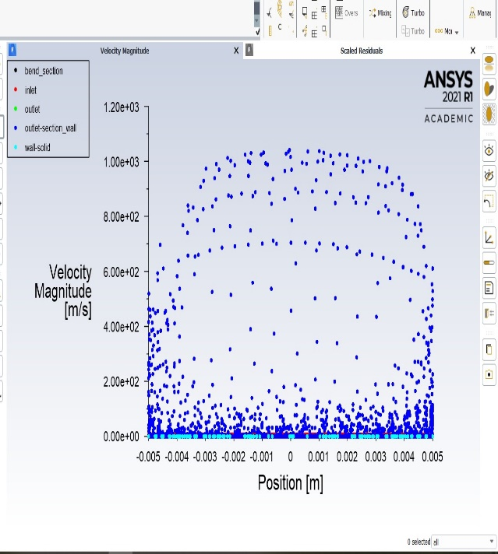
fig.7 Static Pressure V/S Position Graph for 90 Degree Bend
fig. 8 Turbulent Kinetic Energy V/S Position for 90 Degree Bend
fig. 9Velocity V/S Position Graph

Slide 28
5.3 FOR U TUBE BEND PIPE
diameter of pipe=
length of pipe= 250 mm
transform=offset global x
mirror=
volume of complete body= 2.8045e+0.6 mm^3
surface area of complete body = 2.2829e+0.5 mm^2
Meshed Pipe
element order= linear
physicx preference =CFD
Setup
gravity =9.8
viscous laminar
fluid= sodium carboxymethyl cellulose
density= 500 kg/m^3
viscosity= 1.5 kg/ms
material of pipe= aluminium
density= 2719 kg/m^3

Slide 29
velocity inlet =5m/s
Pipe wall
stationery wall
shear condition = no slip
wall roughness constant= 0.5
Solution Method
pressure velocity coupling
scheme= simple
spatial discretization
gradient= green gauss cell based
pressure = second order
momentum= second order upwind
residual monitors
convergence criteria= absolute
Figures
# counters of static pressure #Velocity magnitude vs position(m) #Scaled residual vs iterations
#static pressure vs position(m) #Mass imbalance(kg/s) vs position(m)

Slide 30
REPORT TYPE
pressure at inlet=152951.4
pressure at outlet=0
pressure at pipe wall = 74385.95 pa
#Pressure contour -1
#Velocity contour-2
#Pressure gradient -contour
#Velocity streamline contour
velocity vector-1
sampling= vertex
reduction =reduction factor
variable =velocity
connectivity number
min=2
max=10

Slide 31
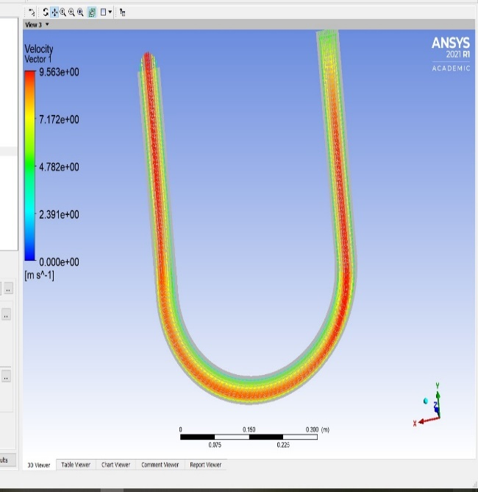
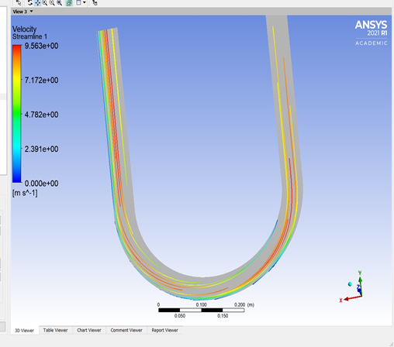
fig. 10 Velocity Vector for U Turn Bend
fig.11 Velocity Streamline for U Turn Bend

Slide 32
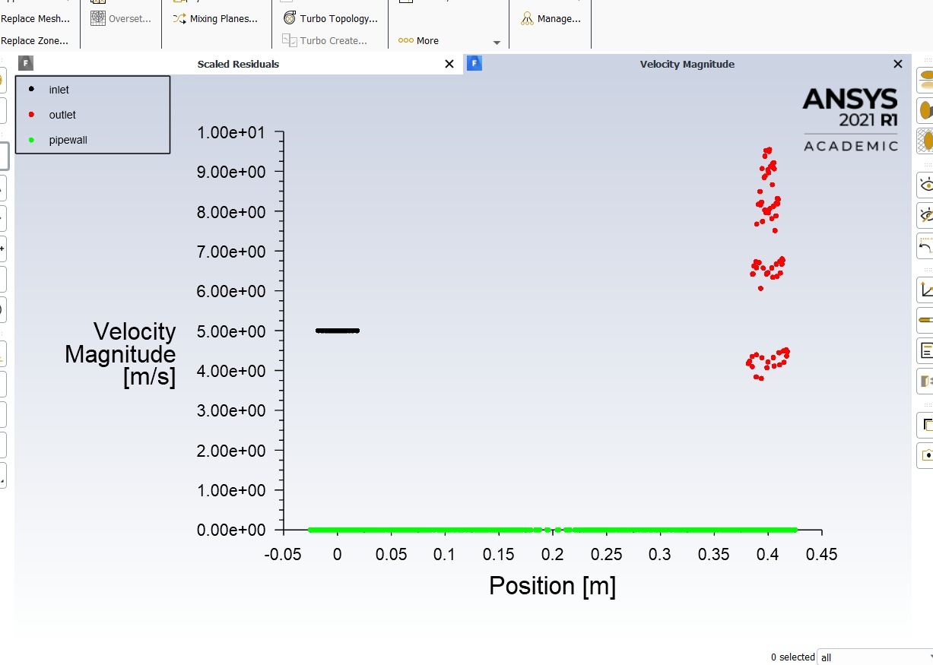
fig.12Velocity Magnitude V/S Position for U Turn Bend

Slide 33
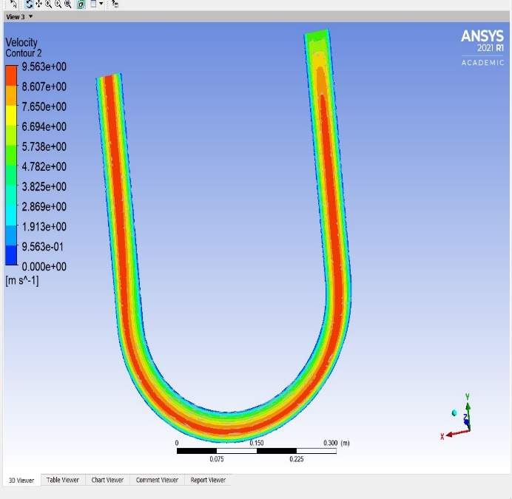
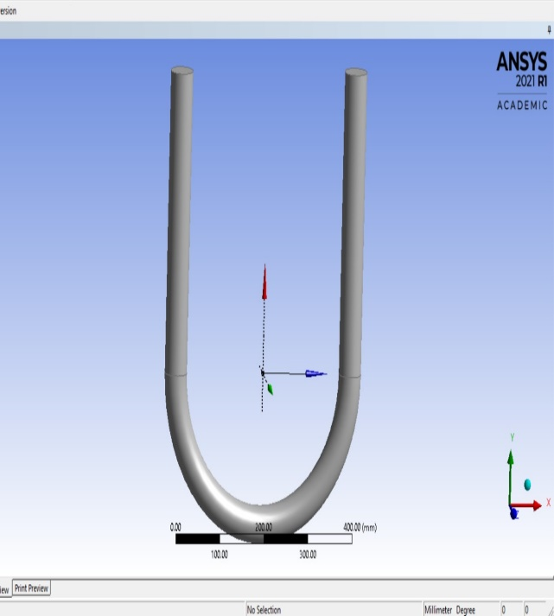
(b)Geometry For U Turn Bend
(a)velocity contour
fig 13 (a),(b)

Slide 34
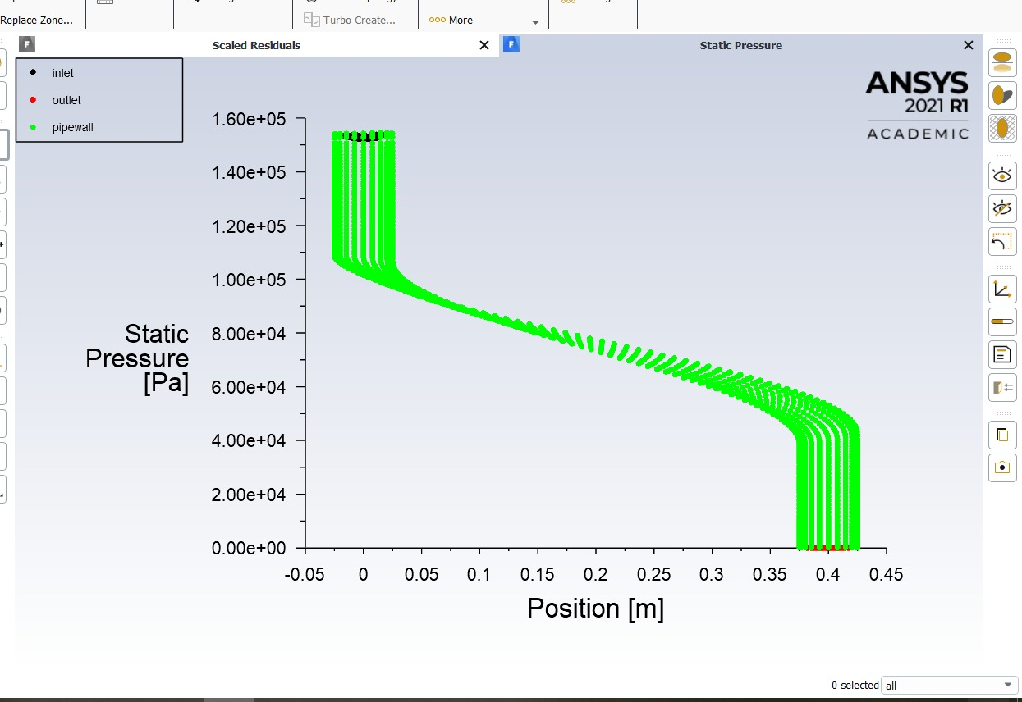
fig.13 Static Pressure V/S Position

Slide 35
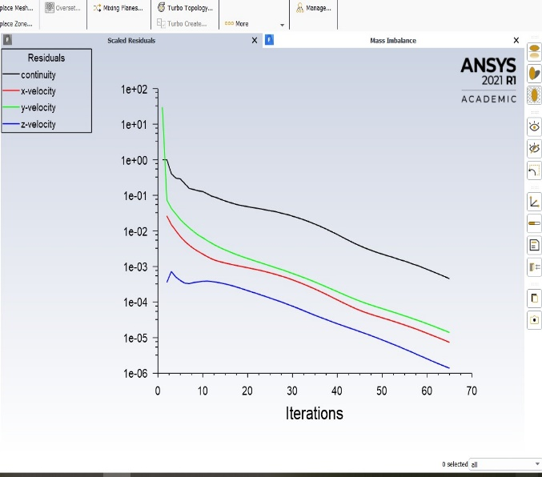
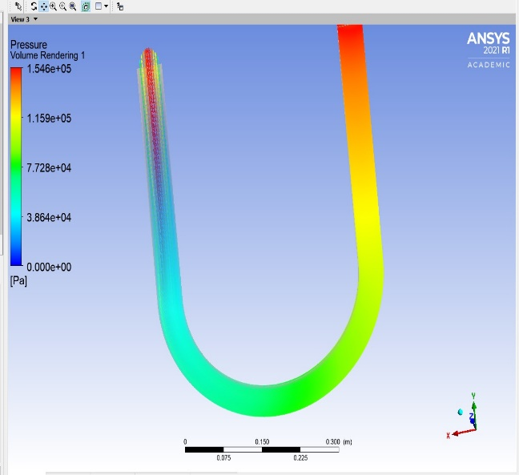
(a)Scaled Residual V/S Position
(b)Pressure Volume Rendering
fig14 (a),(b)

Slide 36
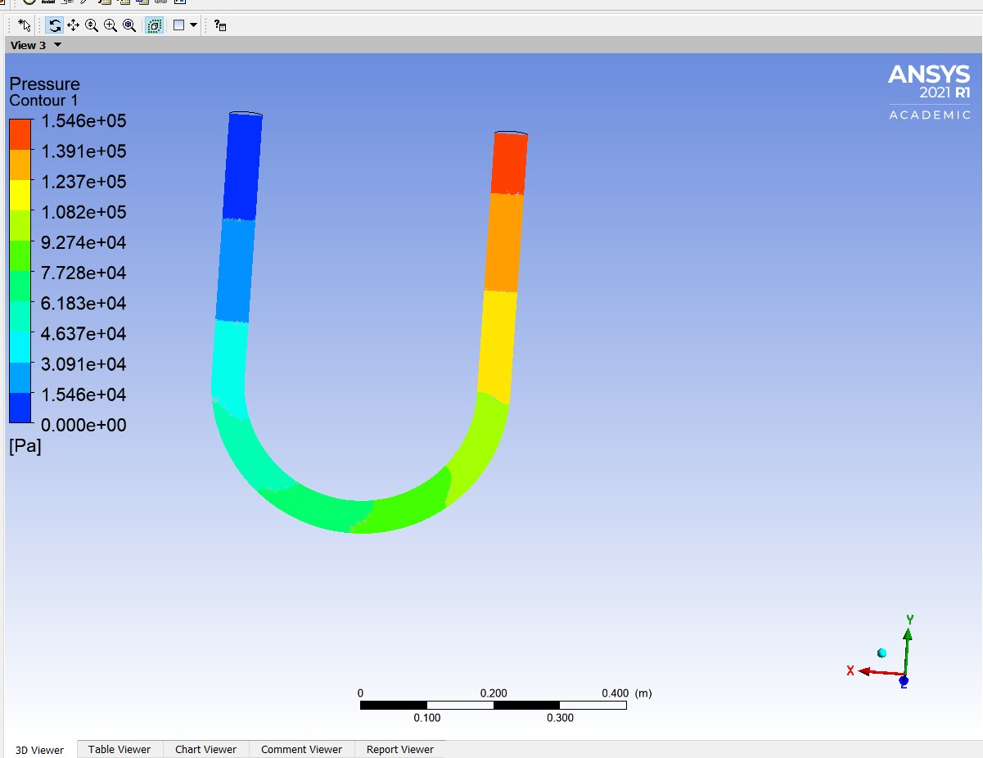
fig.15 Pressure Contour for U Bend

Slide 37
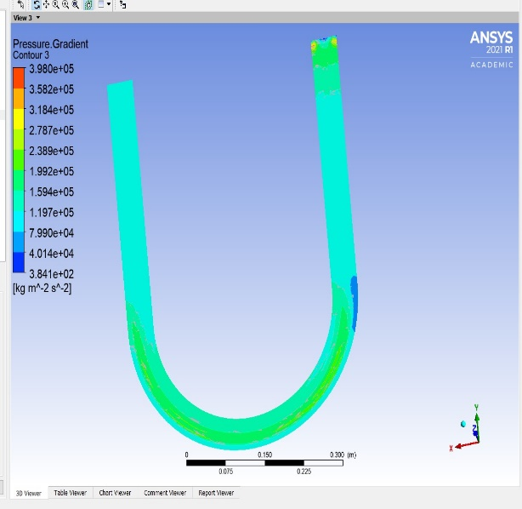
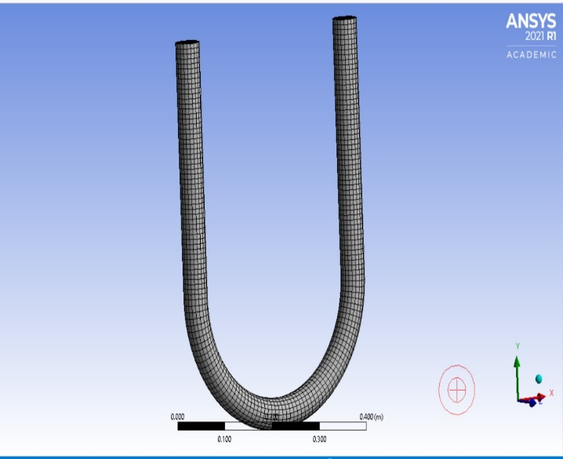
(a)pressure gradient contour 3
(b)mesh design for u bend
fig. 16

Slide 38
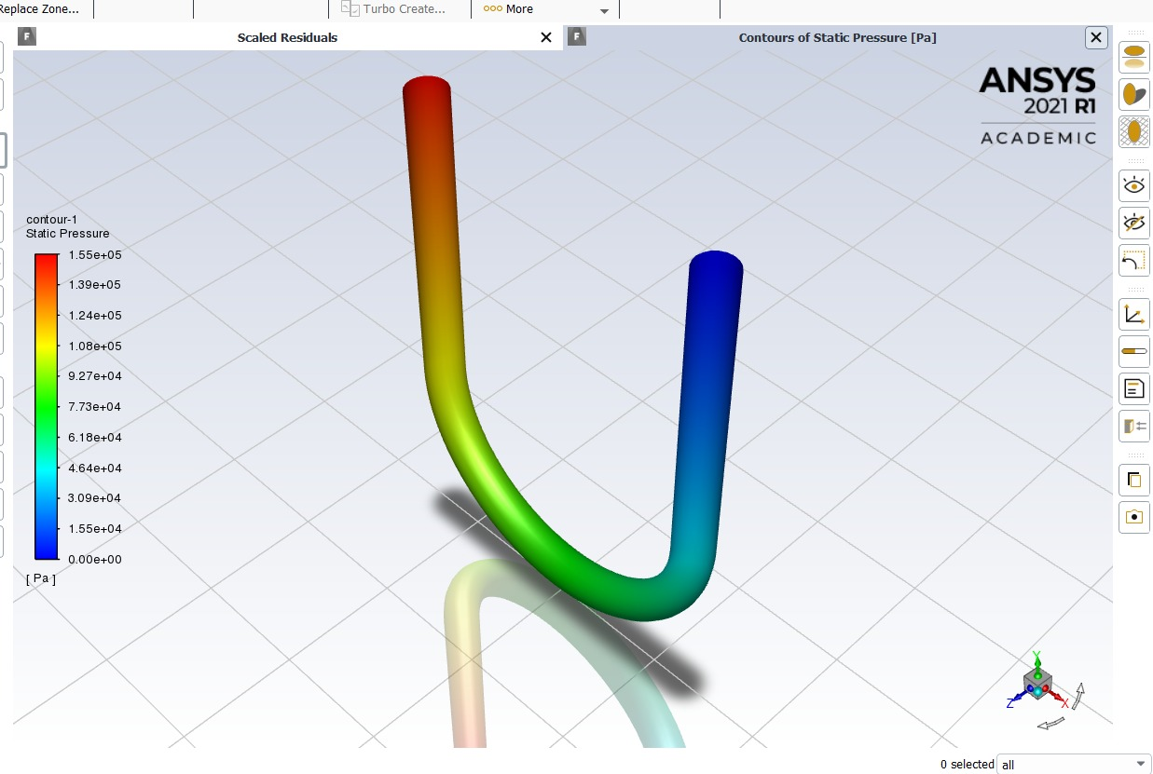
fig .17 contour 1static pressure for U bend

Slide 39
5.4 DISSCUSSION
5.4.1 Effect of bend angle on single-phase pressure drop
Fig. 8 and Fig. 20 show the effect of bend angle on static pressure.
It is clear from the plot that as the bend angle increases, the single-phase pressure drop decreases SCMC.
The reason is that as the magnitude of the secondary flow and the centrifugal forces acting on the liquids are reduced with increasing bend angle and hence the single-phase pressure drop decreases.
The increase of bend angle means low curve and large radius of curvature and hence more closer to behave as a straight pipe which can reduce the centrifugal and secondary forces on the fluid inside the bends and hence reduced the kinetic energy loss.
5.4.2 Effect of bend angle on velocity magnitude, velocity vector
Fig. 5 (a) – (e), Fig. 6 (a) – (f), Fig. 7 (a) – (f) indicate the contour plot of velocity magnitude, velocity vector and dean vortices. From those plots, we observe that the intensities of velocity magnitude, velocity vector are diminished.
This is due to the increase of bend angle, which lowers the intensities of secondary flow phenomena and hence reduce the centrifugal forces on the fluid inside the bend, The centrifugal force is, in principle, balanced by the pressure gradient in the plane of curvature.
However, near the wall where the velocity is small, the pressure gradient can no longer be balanced and consequently fluid in the middle of the pipe moves to the outer wall and then turns to move inwards along the wall.

Slide 40
The flow on the outer wall and separation at the inner wall make the flow very complex.
The increase in bend angle,a lowers the magnitude of Dean Number of bend, Deb = Re (rbp/rcb) 1/2 = Re (dbp/dcb)½ and hence lower the curvature effect value of (dbp/dcb)½.
In this case the curved bend behaves like a straight pipe where the radius of curvature will be a → 0 or dcb → ∞ and hence Re is important than De to lower the intensity of Dean Vortices.
5.4.3 Effect of bend angle on cell Reynolds number and dynamic pressure
Fig. 9 (a) – (e), Fig. 10 (a) – (e), illustrate the contour plot of cell Reynolds number, dynamic pressure .
All are decreased with as increase in the bend angle. This is due to the decreasing of centrifugal forces.
5.4.4 Effect of bend angle on wall shear stress and strain rates
Fig. 12 (a) – (f) and Fig. 13 (a) – (f) show the contour plot of wall shear stress and strain rates which are decreasing with increasing bend angle.
The effects are less pronounced with increasing bend angle as the magnitude of τrɵ components are decreased with angleand thus the magnitude of low angular velocity (ω) lowers the values of shear stress and strain rate.
The shear stress and strain are relatively more near the wall side compared to the central position of the pipe bend as the velocity variation between the fluid layers is more near the wall side compare to the central position

Slide 42
6. REFERENCES
[1] Dean, W. R. "Fluid motion in a curved channel." Proceedings of the Royal Society of London. Series A, Containing Papers of a Mathematical and Physical Character. 121(787), pp. 402-420. 1928.
[2] Dean, W. R. "The Stream-line motion in curved pipes." The London, Edinburgh, and Dublin Philosophical Magazine and Journal of Science. 5(31), pp. 673-693. 1928. https://doi.org/10.1080/14786440408564513
[3] Berger, S. A., Talbot, A., Yao, L. S. "Flow in Curved Pipes." Annual Review of Fluid Mechanics. 15, pp. 461-512. 1983. https://doi.org/10.1146/annurev.fl.15.010183.002333
[4] Soh, W., Berger, S. A. "Laminar entrance flow in a curved pipe." Journal of Fluid Mechanics. 148, pp. 1984. https://doi.org/10.1017/S0022112084002275
[5] Das, S. K., Biswas, M. N., Mitra, A. K. "Friction factor for gas-nonnewtonian liquid flow in horizontal bends." The Canadian Journal of Chemical Engineering. 69(1), pp. 179-187. 1991. https://doi.org/10.1002/cjce.5450690121
[6] Mashelkar, R. A., Devarajan, G. V. " Secondary flows of non-Newtonian fluids: Part I – laminar boundary layer flow of a generalized non-Newtonian fluid in a coiled tube." Transactions of the Institution of Chemical Engineers. 54, pp. 100-107. 1976.
[7] Mishra, P., Gupta, N. "Momentum transfer in curved pipes. 2. Non-Newtonian fluids." Industrial & Engineering Chemistry Process Design and Development. 18(1), pp. 137-142. 1979.
[8] Edwards, M. F., Jadallah, M. S. M., Smith, R. "Head losses in pipe fittings at low Reynolds numbers." Chemical Engineering Research and Design. 63, pp. 43–50. 1985.
[9] Bandyopadhyay, T. K., Das, S. K. "Non-Newtonian pseudo plastic liquid flow through small diameter piping components." Journal of Petroleum Science and Engineering. 55(1-2), pp. 156-166. 2007.

Slide 43
THANK YOU

